Slide 1
NEMDC Open Banking ReST Service Design v1.0
Jasper Thorburn and Jordan Bryan
December 2017
Notes:
Here to give a quick overview of REST service design which is new to NEM.
This was first tested within Open Banking and therefore this presentation will be given from an Open Banking perspective to help illustrate what we did, although REST services are still to be fully defined within NEM.
In Open Banking the design team was
Jordan Bryan
Jasper Thorburn
Tapas Bhattachaya
Thomas Breheny
Pramod Dutt Pant
Jayant Tripathi

Slide 2
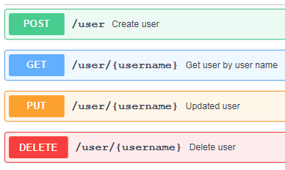
ReST Web Services
Representational State Transfer
POST (Create)
GET (Read)
PUT (Update)
DELETE (Delete)
GET /{AccountId}/balances
Why ReST?
Industry trend moving towards ReST
User friendly standards
Lightweight communication
Less complexity
API economy
Operations on a resource
Notes:
REST is an architecture style to help describe how web services should work.
RESTful services are not dependant on any protocol, but virtually all utilise HTTP as the underlying protocol.
At its simplest, REST web services allow systems to manipulate resources using common operations.
Resources
Resources can be anything from a video, an image or business data.
For example, within Nationwide it may be a customer record, or their accounts or an individual payment.
Operations
These should be the HTTP methods
GET – Read a resource
PUT – Update a resource (should be IDEMPOTENT)
POST – Insert a new resource (is NOT idempotent)
DELETE – Delete a resource
URIs
Used to identify the resource being acted upon
They should not have verbs within them (POST /adduser?name=Robert), this should be purely managed via the HTTP methods.

Slide 3
ReST Service Overview
GET /nem/accounts/v1/{AccountId}/locks
Verb Base Path (inc. major version) Operation f
Expose directory structure-like URIs, comprising of base paths and operation paths.
Base paths = Service Groups
/nem/cabs/v1
/nem/payments/v1
/nem/accounts/v1
Operation Paths = Service Operations
/{AccountId}/locks
/{AccountId}/standing-orders
/{AccountId}/adhoc-payees
/{AccountId}/direct-debits
/{AccountId}/transactions
/{AccountId}/balances
ReST utilises HTTP responses.
HTTP 200 – OK HTTP 404 – Not Found
HTTP 201 – Created HTTP 500 – Internal Server Error
HTTP 400 – Bad Request HTTP 504 – Gateway Timeout
Basepath versions are the Service group version
Notes:
NEM URIs
Within NEM we defined our URIs according to the REST principles
However, we have split them up into base paths and operations to be analogous of our pre-existing service groups and operations.
Base Paths
3 base paths in Open Banking
Within the base path is where we define the MAJOR service versions.
Service Operations
The operations are similar to our existing SOAP service operations
Within the swagger file, the schemaversion is what defines the MINOR service version.
The service gateway will be used to help manage this minor version, just like our existing SOAP services.
HTTP Responses
These will be covered more in detail later.
In general the REST services will always return some type of HTTP response code, broadly success codes or error codes.
There are many different response codes available to use, but within Open Banking we limited this to a smaller list of commonly used ones wherein the body of the message provides the differentiation.
N.B. This list shown isn’t exhaustive, but simply for illustration purposes.

Slide 4
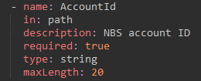
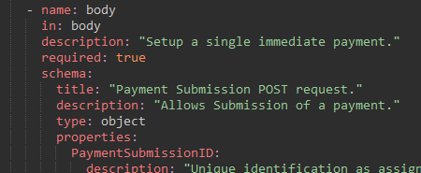
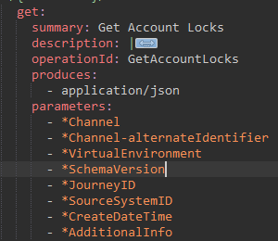
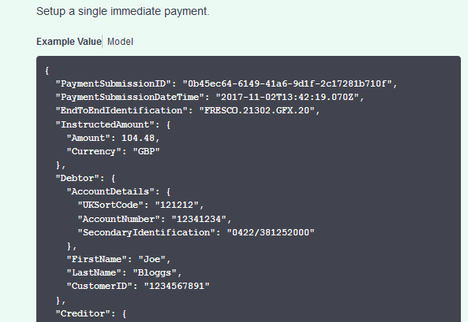
Open Banking Operation Examples
GET Account Locks:
Service header
Parameters - Path| Query String
POST Electronic Payment
Body (unlike GET)
Complex request, simple response
Notes:
Service header per swagger spec. Not currently imported. Future improvement.
GET - Parameters in either path or query string
POST – Parameters in the body.

Slide 5
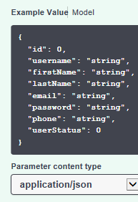
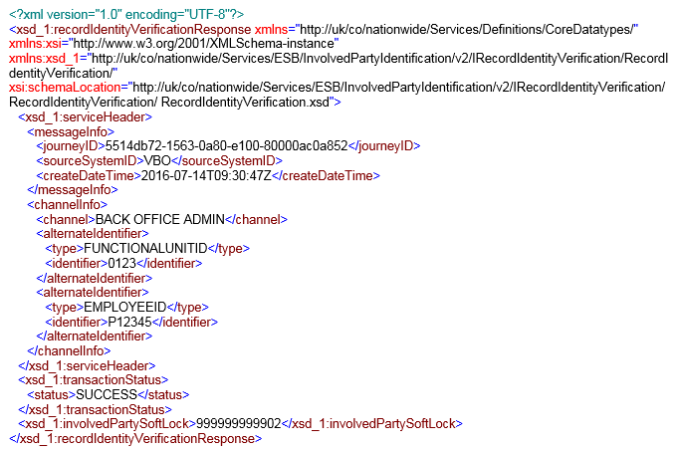
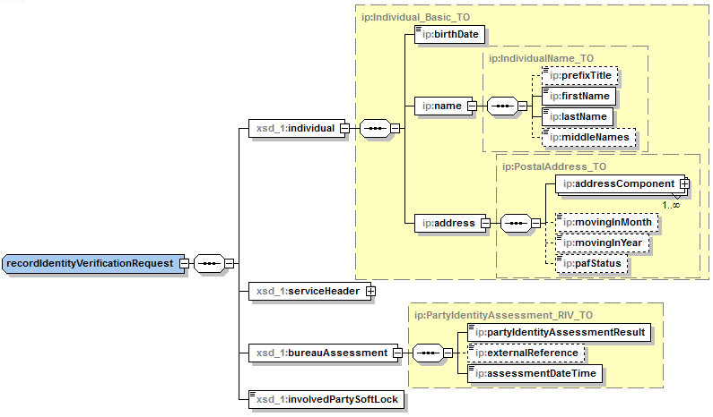




ReST Service Modelling
SOAP (other releases)
RSA
WSDL (XML)
XSD (XML)
XML Spy
Sample Messages (XML)
Direct Design
ReST (open banking)
Swagger
Service Interface (JSON / YAML)
Data Model (JSON / YAML)
Example Messages (JSON / YAML)
Service Groups
Grouped by base path rather than function
Multiple operations per swagger
Notes:
1. Different between soap and rest -> RSA -> swagger.
2. Apply direct design. Build up from requirements, rather than IFW starting point. Look to relate back to IFW when possible.
3. Swagger is versionable component.

Slide 6
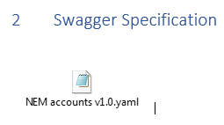
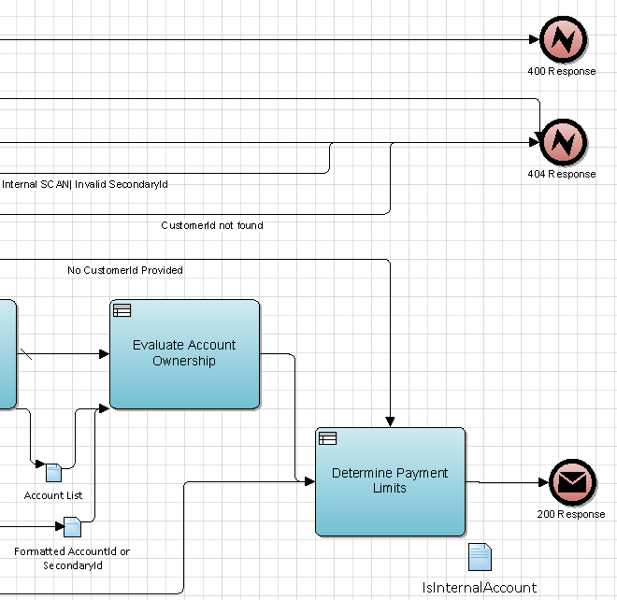
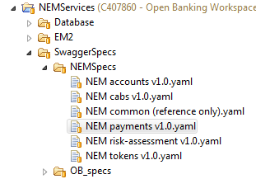

ReSTful Service Design – Documentation
Functional Specs:
Lightweight specs
MVP for service creation
Include Swagger Spec
No duplicate information.
OB Specs and Template Sharepoint Link
Swagger Spec
Limitations (subtyping | polymorphism not yet implemented)
OPM II’s:.
Guiding discussion and presenting.
Complex services where optional calls and alternate paths.
Alternative potential response messages.
Sequence Diagrams:
Currently used for SOAP services.
Do not allow for different HTTP error response types.
Notes:
Func Specs, tuned to build team requirements.
Swagger Interface -> FS supporting doc.
FS allows swagger to become point in time (for releases).
Not currently implemented Subtyping or polymorphism.
Store and version control swagger in RTC via RSA.
Sprints -> OPMs to guide discussion and flush out use cases.

Slide 7
HTTP Responses - Categorisation
HTTP Code | Description | Type | Returned By |  | Swagger Presence | Defined at…
 |  |  | Service | Datapower
200 | OK | Success | ✓ | ✗ | Only when used by a service operation. | Service level
201 | Created | Success | ✓ | ✗
202 | Accepted | Success | ✓ | ✗
304 | Not Modified | Success | ✓ | ✗
409 | Conflict | Error | ✓ | ✗ | Only when used by a service operation. | Swagger level
400 | Bad Request | Error | ✓ | ✓ | Present in all swaggers. | Swagger level
404 | Not Found | Error | ✓ | ✓
500 | Internal Server Error | Error | ✓ | ✓
503 | Service Unavailable | Error | ✓ | ✓
504 | Gateway Timeout | Error | ✓ | ✓
401 | Unauthorised | Error | ✗ | ✓ | Present in all swaggers. | Swagger level
403 | Forbidden | Error | ✗ | ✓
405 | Method Not Allowed | Error | ✗ | ✓
406 | Not Acceptable | Error | ✗ | ✓
429 | Too Many Requests | Error | ✗ | ✓
TransactionStatus is never returned by Datapower responses. It is only returned by service error responses.
Notes:
As noted earlier, NEM decided to utilise only a subset of the full list of HTTP response codes.
Whilst defining these, there were 4 overall categories of how to treat these within the swagger file.
Datapower
One key distinction is that the swagger spec, as a contract to the consumer, should define the responses that could be returned by Datapower as well as by the service itself.
Categories
Provide overview of the table
Examples
Explain examples of each, either in swagger editor or via the appendix slides.

Slide 8
Any questions?
?

Slide 9
Appendix
Overview:
https://www.ibm.com/developerworks/library/ws-restful/index.html/
http://www.drdobbs.com/web-development/restful-web-services-a-tutorial/240169069
Basic Design Principles:
Use HTTP methods explicitly -> GET(read)/PUT(Update/Replace)/POST(Create)/DELETE
http://www.restapitutorial.com/lessons/httpmethods.html
http://www.restapitutorial.com/httpstatuscodes.html#

Slide 10
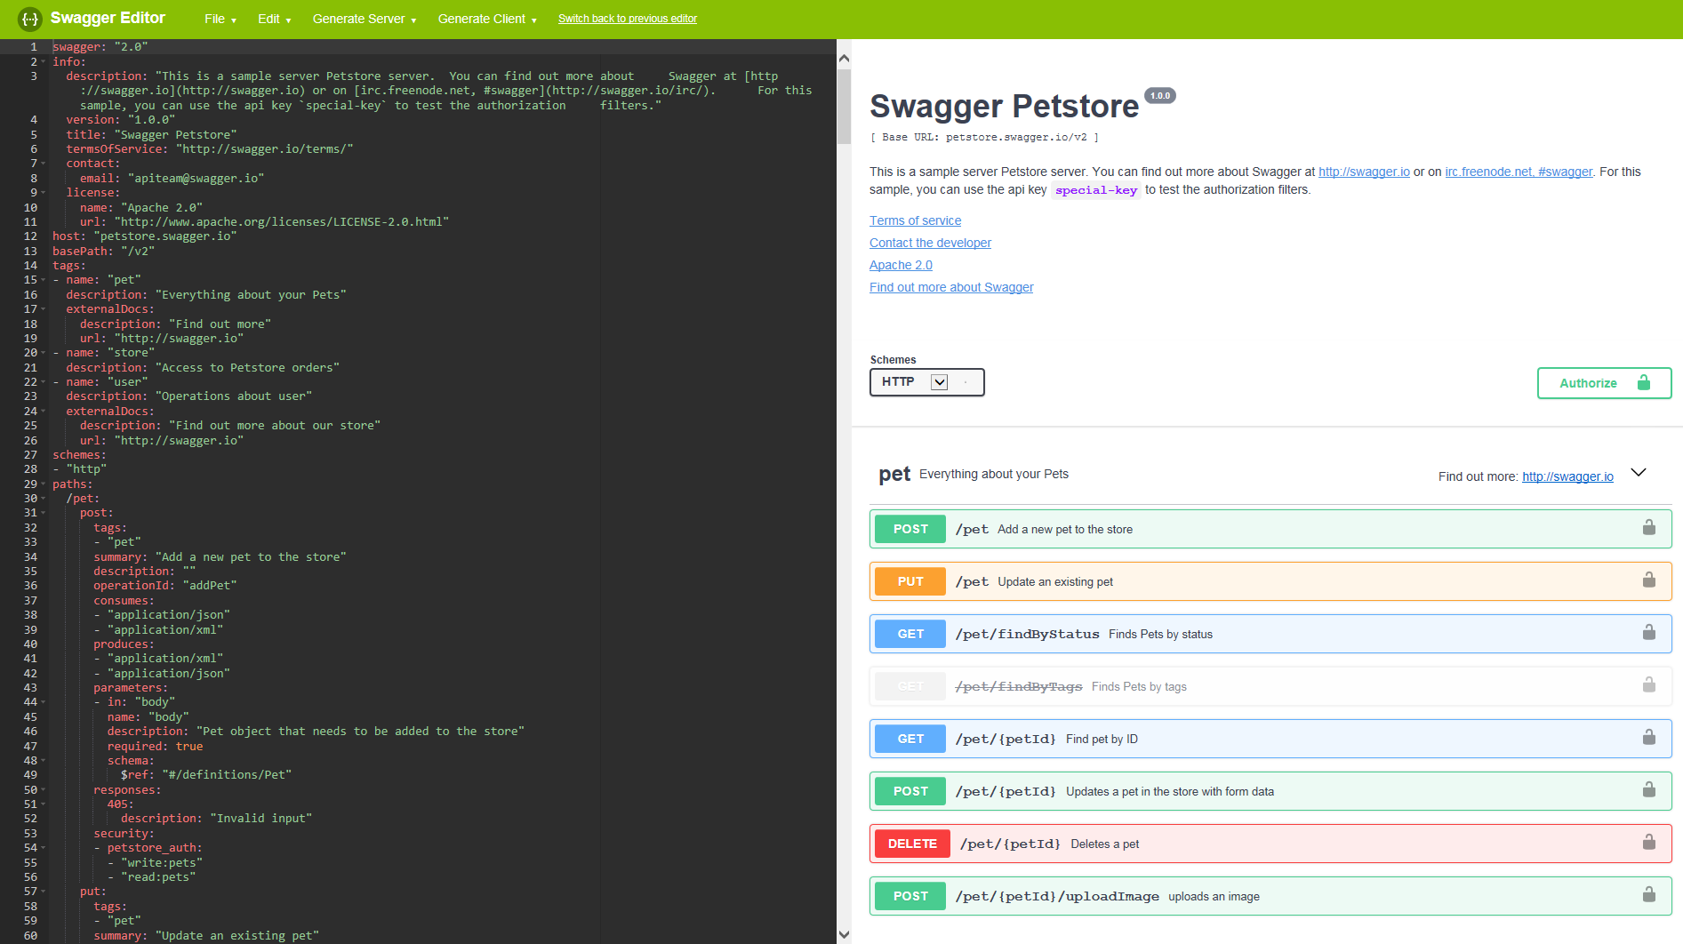
Swagger Editor

Slide 11
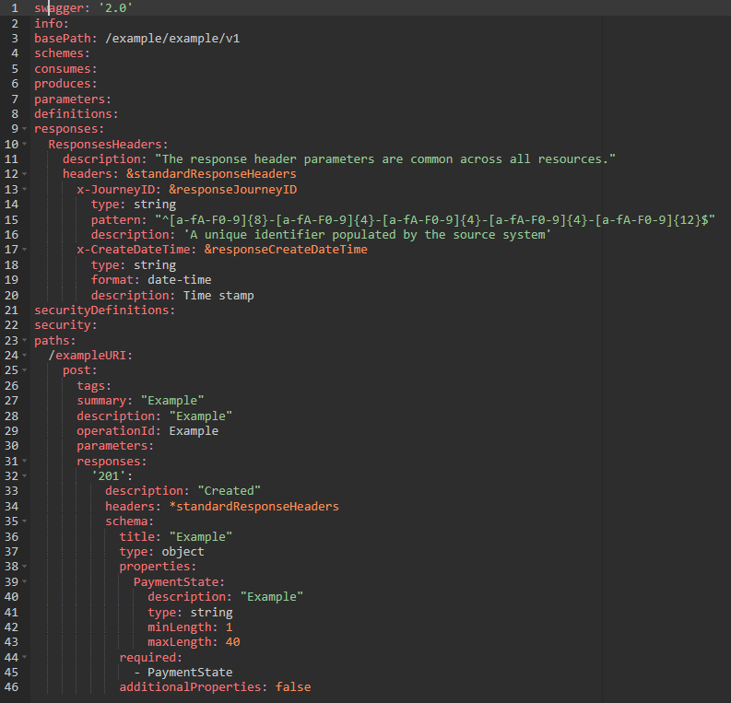
Appendix HTTP Responses – Categorisation Example
HTTP Code | Description | Type | Returned By |  | Swagger Presence | Defined at…
 |  |  | Service | Datapower
200 | OK | Success | ✓ | ✗ | Only when used by a service operation. | Service level
201 | Created | Success | ✓ | ✗
202 | Accepted | Success | ✓ | ✗
304 | Not Modified | Success | ✓ | ✗
No TransactionStatus
Response headers Included
Included and defined at service level

Slide 12
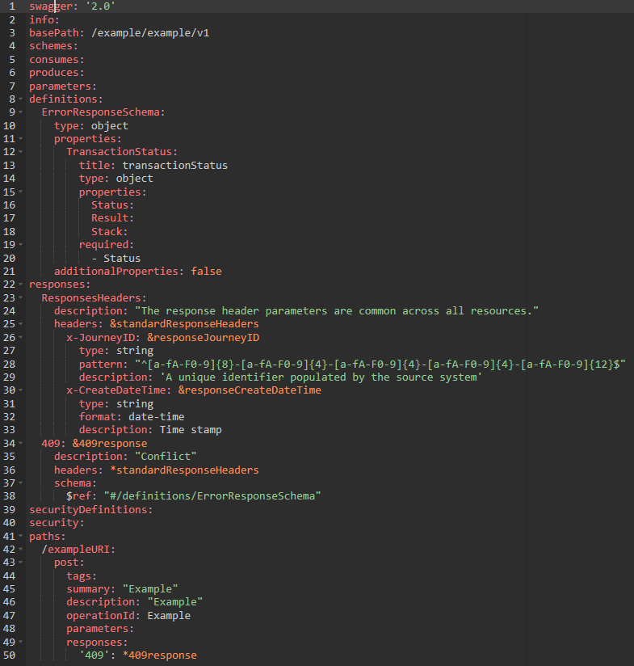
Appendix HTTP Responses – Categorisation Example
HTTP Code | Description | Type | Returned By |  | Swagger Presence | Defined at…
 |  |  | Service | Datapower
409 | Conflict | Error | ✓ | ✗ | Only when used by a service operation. | Swagger level
Included TransactionStatus
Response headers Included
Defined at swagger level
Only referenced at service level

Slide 13

Appendix HTTP Responses – Categorisation Example
HTTP Code | Description | Type | Returned By |  | Swagger Presence | Defined at…
 |  |  | Service | Datapower
400 | Bad Request | Error | ✓ | ✓ | Present in all swaggers. | Swagger level
404 | Not Found | Error | ✓ | ✓
500 | Internal Server Error | Error | ✓ | ✓
503 | Service Unavailable | Error | ✓ | ✓
504 | Gateway Timeout | Error | ✓ | ✓
Included TransactionStatus
Response headers Included
Defined at swagger level
Optionally referenced at service level

Slide 14
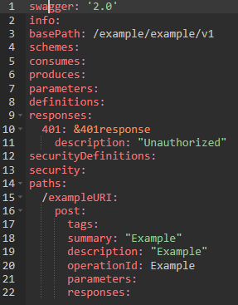
Appendix HTTP Responses – Categorisation Example
HTTP Code | Description | Type | Returned By |  | Swagger Presence | Defined at…
 |  |  | Service | Datapower
401 | Unauthorised | Error | ✗ | ✓ | Present in all swaggers. | Swagger level
403 | Forbidden | Error | ✗ | ✓
405 | Method Not Allowed | Error | ✗ | ✓
406 | Not Acceptable | Error | ✗ | ✓
429 | Too Many Requests | Error | ✗ | ✓
No response headers or TransactionStatus
Defined at swagger level
NOT referenced at service level

